Slide 1


DELIVERING THE SUN’S PROMISE
能源之诺｜向阳而生
SHENZHEN SOLAR RUN ENERGY CO.,LTD.
深圳市向阳新能源科技有限公司

Slide 2











ONE-STOP SOLAR SOLUTION
SOLAR RUN ENERGY
Founded in 2016, Solar Run Energy is committed to empowering weak-grid and off-grid areas with Affordable, Accessible, and Sustainable solar solutions. Our professional and agile team is motivated by a dream to accelerate the clean energy access in Africa and drive a sustainable future.
Based on our in-depth understanding about consumers in weak-grid and off-grid areas, we developed a comprehensive solar product portfolio with/without PAYGo function, from portable lamps to DC appliances, and to kilowatt solar energy storage systems.
Our Core Strengths:
Expertise in VeraSol (LG) Standards (22 VeraSol-certified models)
In-market offices (Nigeria, Kenya, Ethiopia, Cote d’Ivoire)
SKD factory in Ethiopia
Expertise in PAYGo (since 2016)
16-year factory with 2.1M production capacity
Solar Run Energy established cooperation with many international partners, including UN agencies, NGOs, Fortune 500 companies, and a lot more. By collaborating with partners, we achieved significant impacts:
60+
Countries
8.15 million
Lives Empowered
1.63 million
Off-grid Family
138.6 million
Additional Income Generated
2.02 million
Tons of CO2 Offset
We are a proud member of UN Global Compact, GOGLA, Catalyst 2030, and also awarded with the EcoVadis Silver Medal.

Slide 3
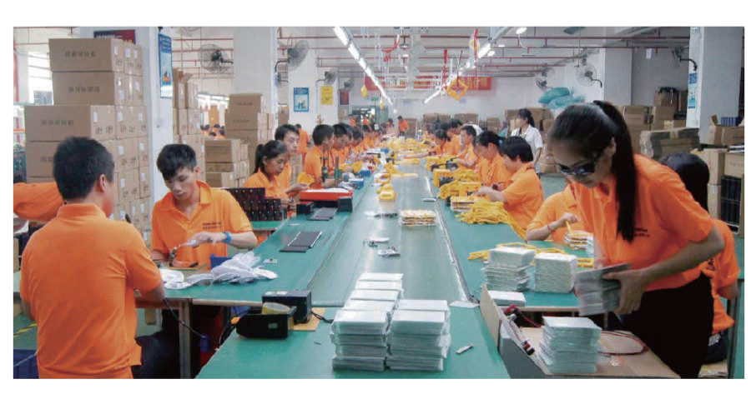
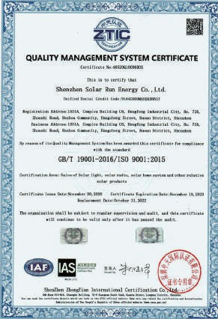
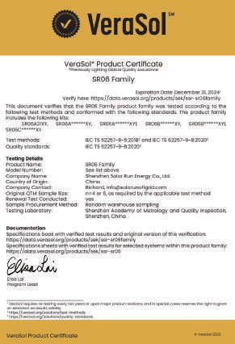
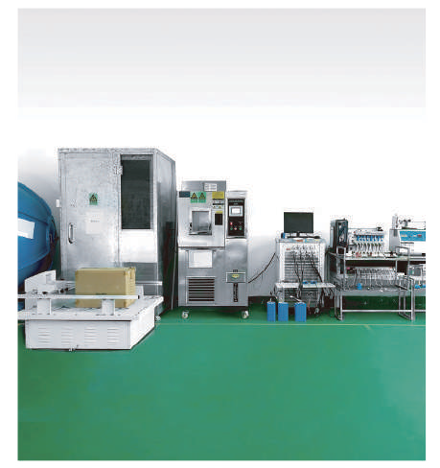
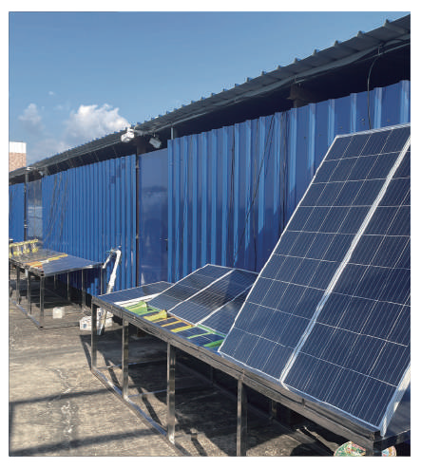


FACTORY BASE
CERTIFICATION
Production Line
ISO 9001
VeraSol certified products
Indoor Test Lab
Outdoor Test Lab
EcoVadis Certification

Slide 4
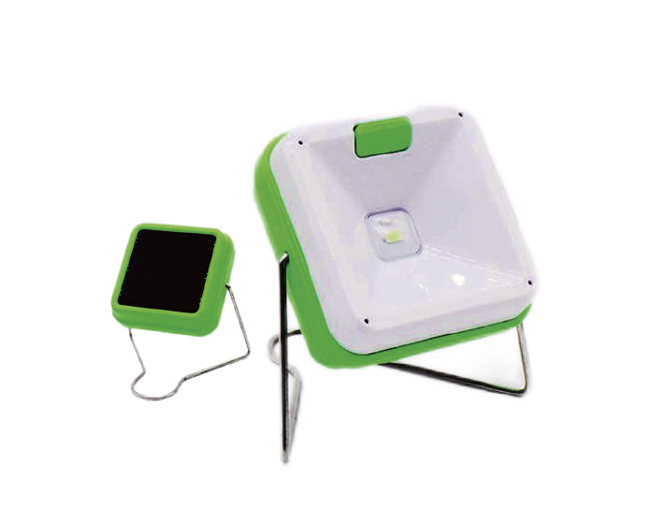



FIREFLY
CANDLES KILLER
Hangable and portable stand design
Two brightness settings
1.5+ hours of light with full battery
3x brighter than kerosene
Model No.
SR07
Working/Charging Time
5 hours
Battery Capacity
3.2V / 400mAh
Battery Type
LiFePO4
Solar Panel Power
0.3W

Slide 5
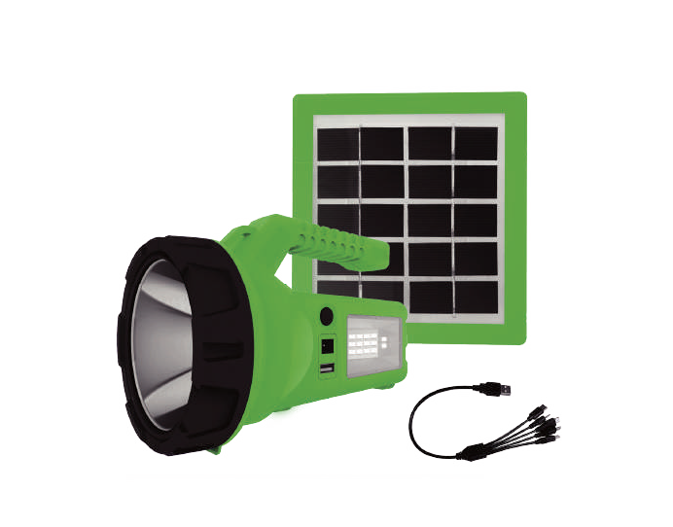








SOLARBEAM ^{TOGETHER}
WE MAKE LIFE BETTER
Outdoor activity
Bright torch function
Reading
SOS
Phone charging
Super sidelight
Model No.
SR067T1
Battery Voltage/Type
3.2V/LiFePO4
Battery Capacity
10.56Wh(3.3Ah)
Solar Panel Power
3W
Brightness
150LM/250LM/70LM

Slide 6
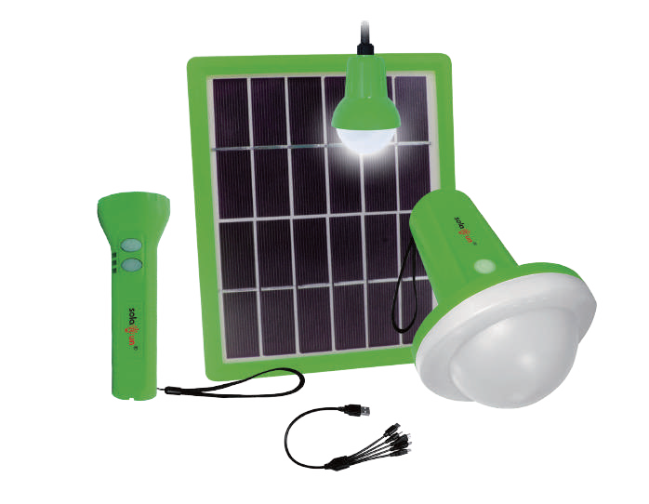



WELITE SMART LIGHT
Waterproof IP65
Phone charging
30x bright than kerosene
Up to 20 hours of light
hangable and portable
Remote control (small torch)
Model No.
SR12A
SR12B
Battery Voltage/Type
3.2V/LiFePO4
Battery Capacity
19.2Wh (6Ah)
10.56Wh (3.3Ah)
Lantern
20LM/120LM/200LM/300LM
Bulb
1W/120LM
/
Solar Panel Power
5W
3W

Slide 7


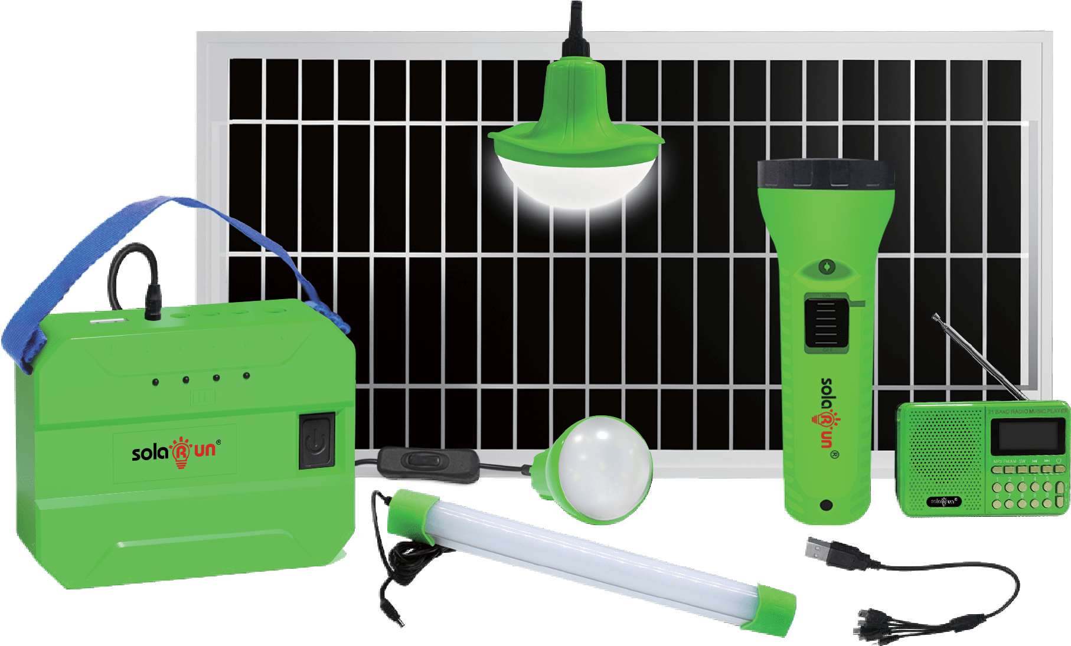


POPBOX
SMALL BOX, BIG POWER
54x brighter than kerosene
Rechargeable Radio & torch
Powerful 3+ light & free mobile charging
2000 cycles LiFePO4 battery
Light up multiple rooms
VeraSol-certified product
Model No.
SR06A
SR06B
SR06C
Battery Voltage/Type
6.4V/LiFePO4
Battery Capacity
38.4Wh (6Ah) 23.04Wh(3.6Ah) 38.4Wh(6Ah)
High brightness 2W/240LM, 3W/360LM 10W 6W 15W
Bulb/Tube Light
Solar Panel Power

Slide 8



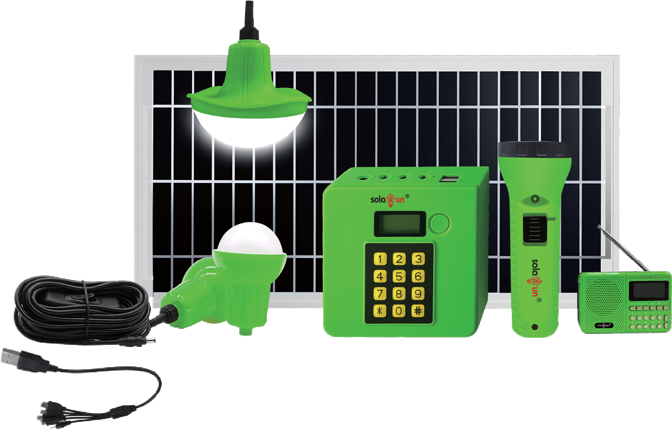

ECOBOX
THE MOST AFFORDABLE PAYG SHS
Pay-As-You-Go function available
LED battery level & credit indicator
46x brighter than kerosene
2000 cycles LiFePO4 battery
Powerful 3+ light & free mobile charging
VeraSol-certified product
Model No. | SR24B | SR24C
Battery Voltage/Type | 6.4V/LiFePO4
Battery Capacity | 38.4Wh (6Ah)
Bulb | High brightness 2W/240LM
Solar Panel Power | 10W | 15W

Slide 9


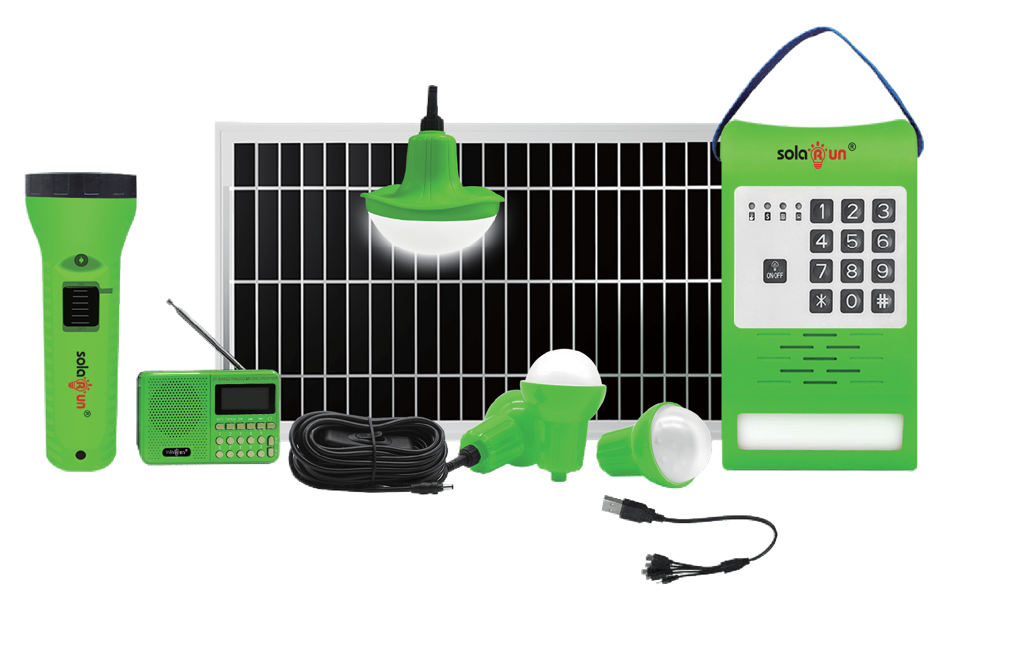


YELLOBOX
YELLO! TO BRIGHT LIFE
Pay-As-You-Go function available
Wall light with 3 brightness level
66x brighter than kerosene
2000 cycles LiFePO4 Battery
Powerful 3+ Light & Free Mobile Charging
VeraSol-certified product
Model No.
K088T2
K088T3
K088T5
Battery Voltage/Type
6.4V/LiFePO4
Battery Capacity
38.4Wh (6Ah)
76.8Wh(12Ah)
76.8Wh(12Ah)
Bulb
High brightness 2W/240LM
Solar Panel Power
12W
15W
20W

Slide 10
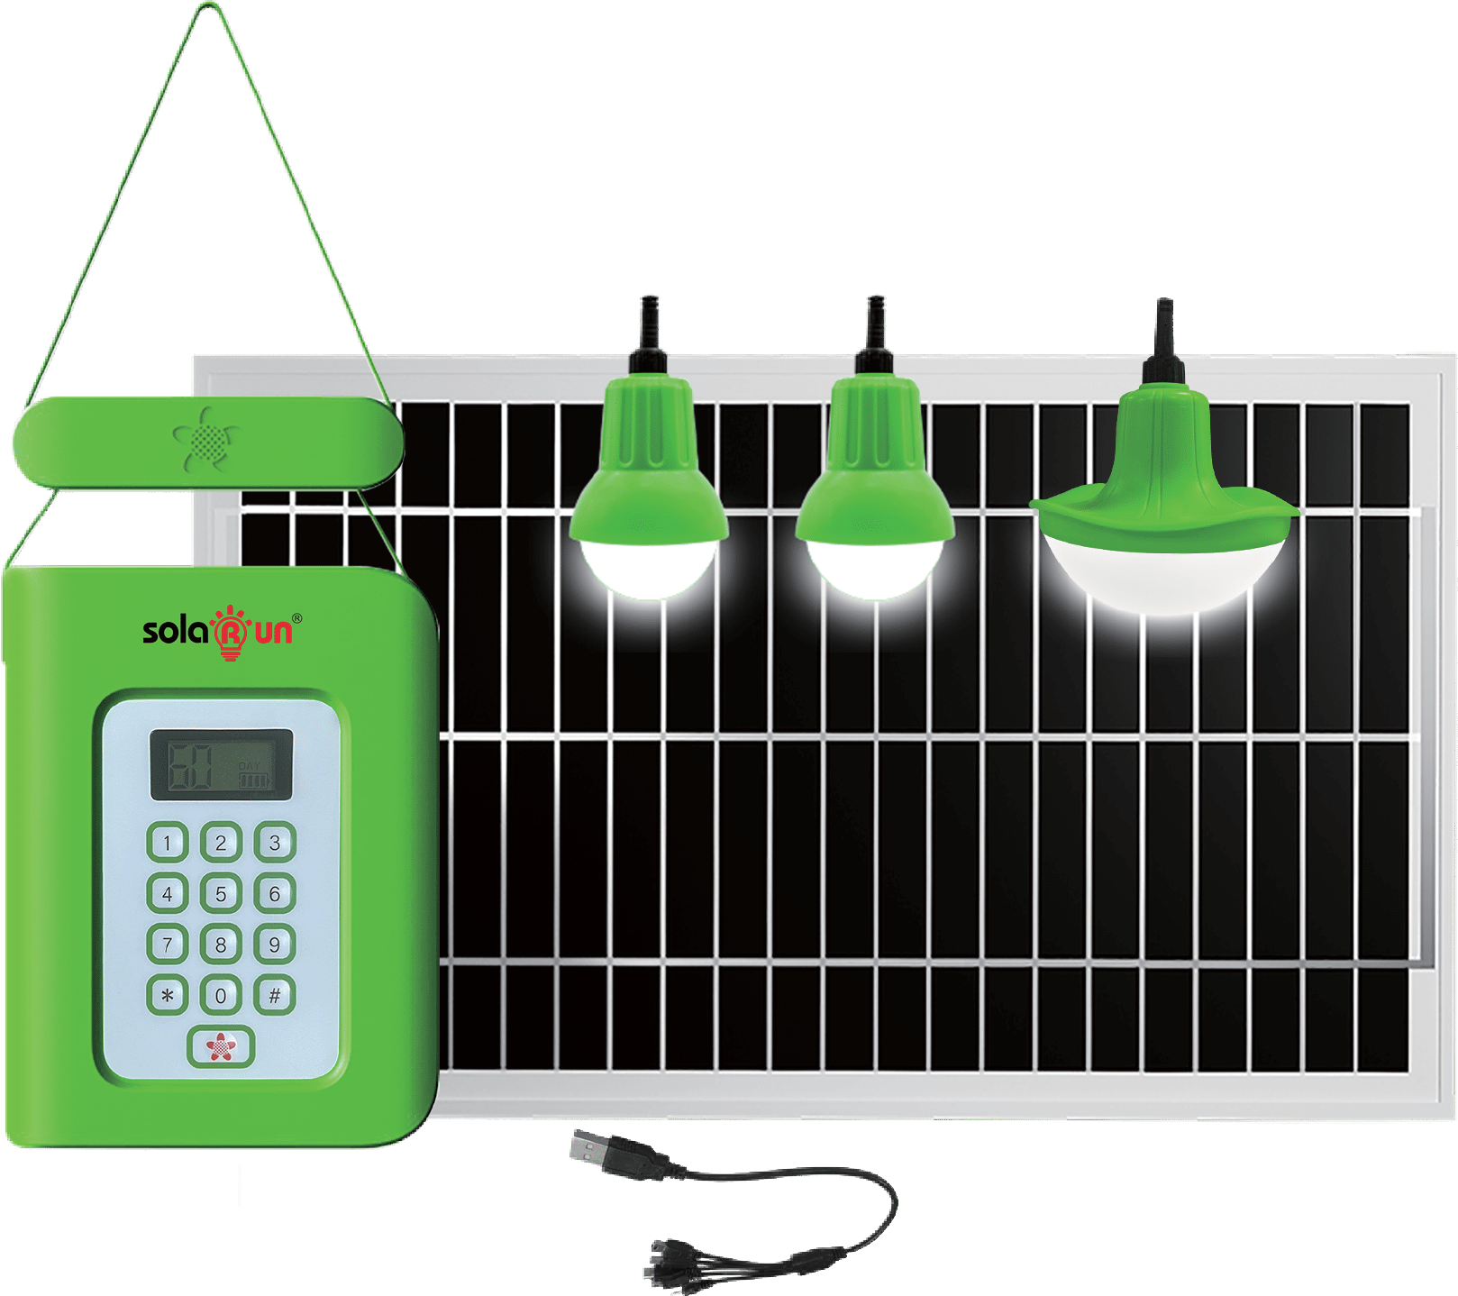


ECOSHINE
LET THE SUN LIGHT YOUR WAY
Pay-As-You-Go function available
LED battery level & credit indicator
54x brighter than kerosene
2000 cycles LiFePO4 battery
Powerful 3+ light & free mobile charging
Light up multiple rooms
Model No.
SR26
Battery Voltage/Type
6.4V/LiFePO4
Battery Capacity
38.4Wh(6Ah)
Bulb
High brightness 2W/240LM
Solar Panel Power
12W

Slide 11


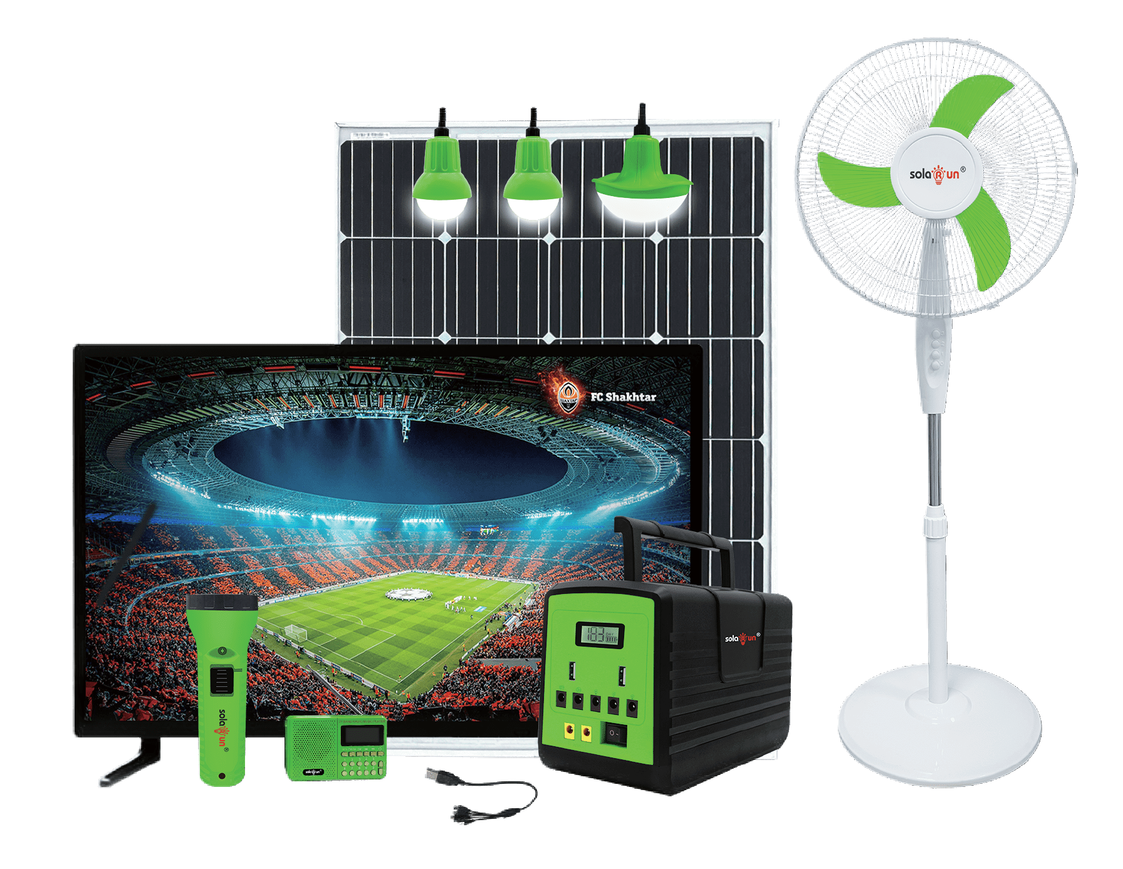






APOLLO THE SUPER POWER STATION
Power TV and fan for long time
Light up multiple rooms
Paygo function available
5 years life span, 2 years warranty
VeraSol-certified product
LCD battery level & credit indicator
Model No.
SR31B
SR31C
Battery Voltage/Type
12.8V/LiFePO4
Battery Capacity
153.6Wh (12Ah)
230.4Wh (18Ah)
Bulb
High brightness 3W/360LM
Solar Panel Power
40W
50W

Slide 12


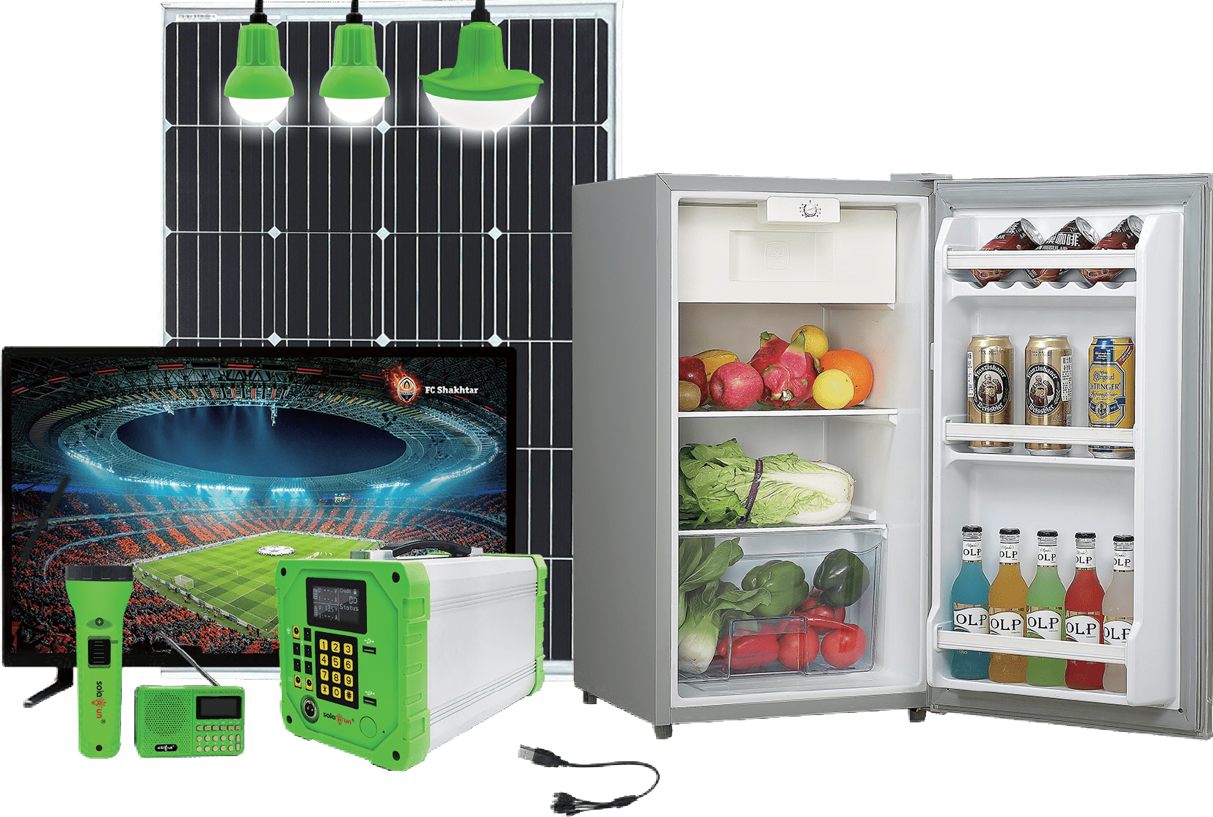


MBOX
POWER WHATEVER YOU WANT
Super power battery
for appliances
8 outputs for lighting and home applications
Paygo function available
5 years life span 2 years warranty
VeraSol-certified product
LCD battery level & credit indicator
Model No.
SR32B
SR32C SR32E
12.8V/LiFePO4
384Wh (30Ah) 614.4Wh (48Ah)
High brightness 3W/360LM 100W 150W
SR32F
Battery Voltage/Type
Battery Capacity
307.2Wh (24Ah)
768Wh (60Ah)
Bulb
Solar Panel Power
80W
200W

Slide 13
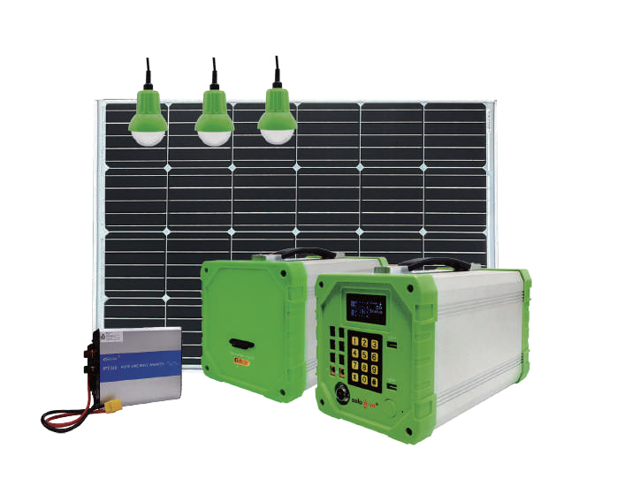



SOLAR AC SYSTEM
Super Power Battery for Appliances
8 Outputs for lighting and home applications
Paygo function available
Support AC/DC
Fully charged in 5 hours
LCD battery level & credit indicator
Model No.
SR32D Plus
SR32E Plus
SR32F Plus
Battery Voltage/Type
12.8V/LiFePO4
Battery Capacity
460.8Wh(36Ah)
614.4Wh(48Ah)
768Wh(60Ah)
Bulb
High brightness 3W/360LM
Solar Panel Power
120W
150W
200W
Inverter
150W
150W
300W

Slide 14

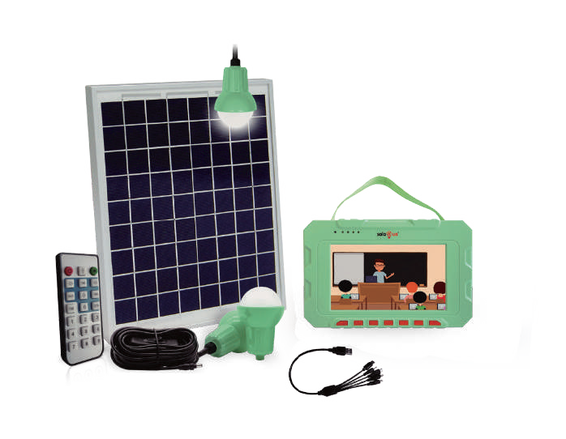



SOLAR MEDIA FOR NEXT GENERATION
With video and audio function
Light up rooms while playing
Store any information you prefer
Used for promotion, professional training and entertainment
Empower people with educational knowledge
VeraSol-certified product
Model No.
SR77B
Battery Voltage/Type
6.4V/LiFePO4
Battery Capacity
76.8Wh(12Ah)
Bulb
High brightness 3W/360LM
Solar Panel Power
20W

Slide 15
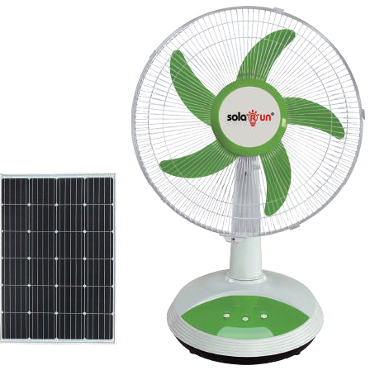


SOLAR RECHARGEABLE FAN
30 Hours run time
Blow up to
6.2 meters
Brushless motor
2 Modes led light
3 Speed modes
Low power consumption
Model No.
SR-FR16T
Size
16inch 5 Blades
Battery
Li-ion, 7.4V ,7.2Ah
Solar Panel
11V/20W, 5m cable
Charging Time
4 hours
Run Time
30 hours(Low)
9 hours(Mid)
4 hours(high)

Slide 16
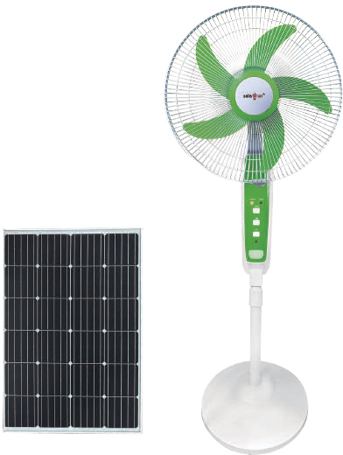

SOLAR RECHARGEABLE FAN
30 Hours run time
Blow up to 6.2 meters
Brushless motor
3 Speed modes
Height adjustable
Low power consumption
Model No.
SR-PR16T
Size
16inch 5 Blades
Battery
Li-ion, 7.4V ,7.2Ah
Solar Panel
11V/20W, 5m cable
Charging Time
4 hours
Run Time
30 hours(Low)
9 hours(Mid)
4 hours(high)

Slide 17
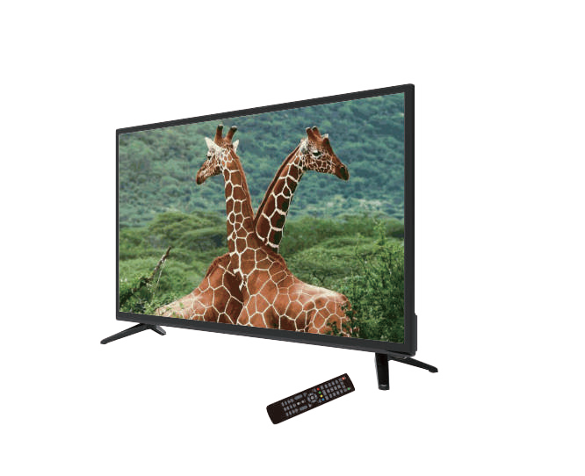


DC TV
Low power consumption
High definition screen
Supports TF card & USB disk
Built-in DVB-T2+S2 tuner
Model No.
SR-TV24
SR-TV32
SR-TV43
Size
24 inches
32 inches
43 inches
Input Voltage
DC 12V
Power
10W
13W
15W
Display Type
TFT-LCD
Input Port
HDMI,S-VIDEO,VGA,USB,TV,AV

Slide 18
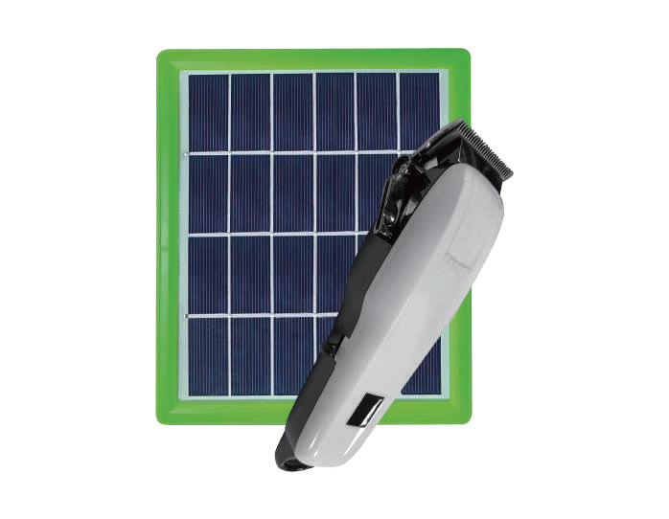


SOLAR HAIR CLIPPER
most powerful motor
3 Hours charging
180 minutes use
adjustable blade
Li-ion battery
Model No.
SR-Barber01
Input Voltage
5V/1A
Battery Capacity
Li-ion 3.7V/2000mAh(7.4Wh)
Solar Panel Power
3W
Charging Time
5-7H
Run Time
3-3.5H

Slide 19


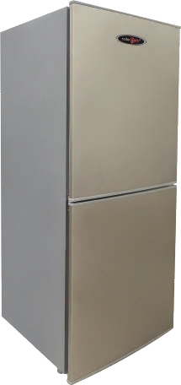


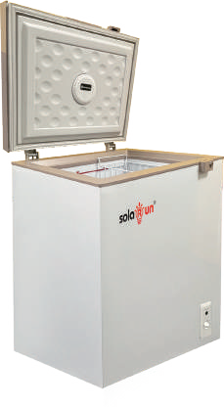
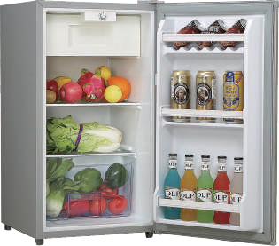
DC FRIDGE & FREEZER
Cycle refrigeration
Adjustable temperature
Low power consumption
Efficient cooling
Model No.
BC100 BCD150
BD100
Function
Fridge + Freezer
Fridge / Freezer
Capacity
90L
150L
108L
Input Voltage
DC 12V
Power
20W
30W
40W
Refrigerant
R600A

Slide 20

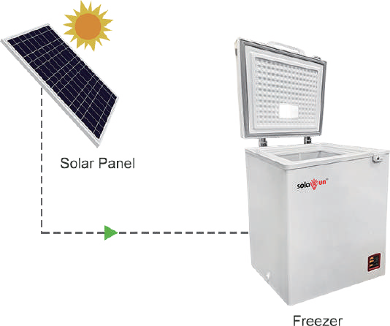

SOLAR POWERED FREEZER
With PAYGo optional
Solar drive directly
Adjustable temperature
Low power consumption
Efficient freezing
24H long-Term insulation
Cycle refrigeration
Model No. | SR-BCD-100 | SR-BCD-200 | SR-BCD-300
Function | Fridge / Freezer | Fridge / Freezer | Fridge / Freezer
Capacity | 108L | 208L | 308L
Input Voltage |  | 24V~60V
Power | 45W | 55W | 85W
Refrigerant | R600A | R600A | R600A
Battery Capacity | 12.8V/12Ah(153.6Wh) | 12.8V/24Ah(307.2Wh) | 12.8V/36Ah(460.8Wh)
Solar Panel Power | 340W | 460W | 550W

Slide 21

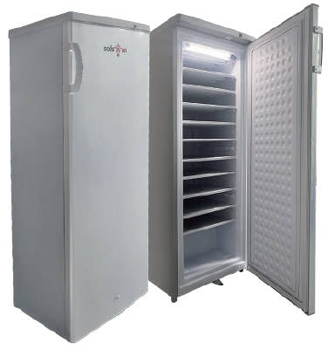
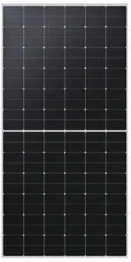

SOLAR POWERED ICE MAKER
Solar drive directly
Adjustable temperature
Low power consumption
Efficient freezing
24H long-Term insulation
Cycle refrigeration
Model No.
SR-BD-198
Capacity
198L
Temperature Range
≤ -18 for freezer
Input Voltage
12V/24V/220V
Refrigerant
R134A/R600A
Battery Capacity
25.6V/250AH(6.4kWh)
Solar Panel Power
550W*3

Slide 22



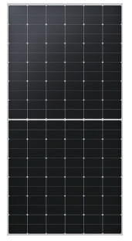
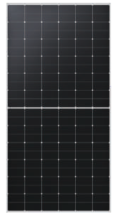
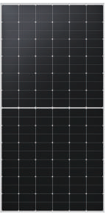

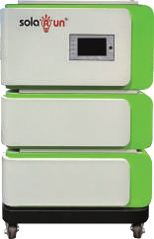


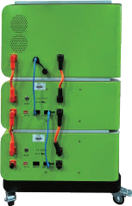





PAYG MODULAR SOLAR INVERTER SYSTEM
HIMO DUST FREE
Solar energy
Load
Grid
Generator
GPRS remote control.
Integrated
Power frequency
Paygo function available
3 years warranty
monitoring and data
inverter-battery
inverter
Extendable battery
collecting
Item NO
Solar Panel
Battery
Battery Capacity
Inverter
Daily Power Generation
SR-GP2000M
550W*2
51.2V/50Ah*1(5.56KWh)
2KW
7.70KWh
BYD LiFePO4
SR-GP3000M
550W*4
51.2V/50Ah*2(5.12KWh)
3KW
11.55KWh
SR-GP5000M
550W*10
51.2V/50Ah*4(10.24KWh)
5KW
19.25KWh

Slide 23
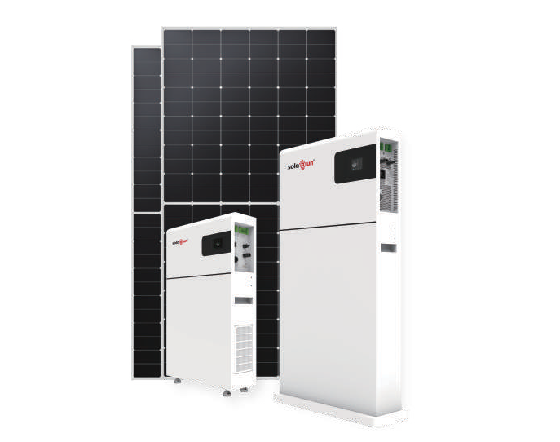












All-in-one Solar Storage System
5
Advanced Design
All in one design, compact and elegant appearance, 15cm thickness
Both PV and grid charge, fast and convenient Peak-shaving mode, reduce the electricity bill
YEARS
High Reliability
Integrate 8/10.24kWh battery, long time power supply LFP battery cell technology, safe than ever
Multiple protections,safe and reliable
Solar energy
Load
Grid
User-Friendly
Multiple work modes, meet lots of scenarios LCD touch screen design
Ideal for residential application with low operating noise
Generator
Model No.
SR-GP3680
SR-GP5011
Inverter Output
3600W(Rated Power)
5000W(Rated Power)
Battery
LFP; 25.6V/312Ah(8kWh)
LFP; 51.2V/200Ah(10.24kWh)
PV Input
5000W
5500W
AC Input
208/220/230/240Vac, 50/60Hz
208/220/230/240Vac, 50/60Hz
AC Output
3600W
5000W

Slide 24
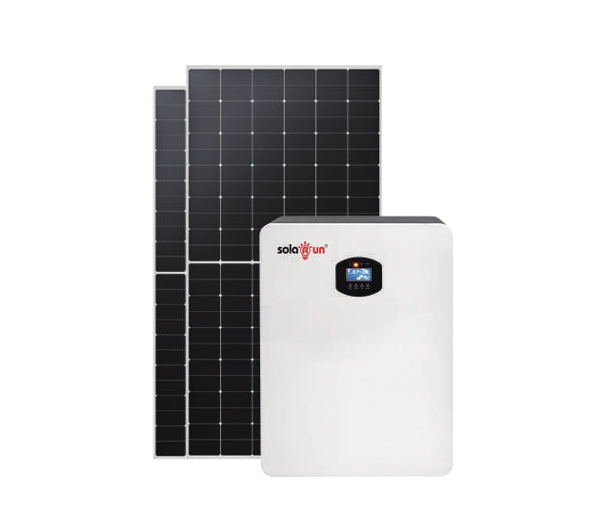










All-in-one Solar Storage System
5
Advanced Design
All in one design, compact and elegant appearance Both PV and grid charge, fast and convenient
Peak-shaving mode, reduce the electricity bill
YEARS
Solar energy
High Reliability
Integrate 2.56kWh battery, long time power supply LFP battery cell technology, safe than ever Multiple protections,safe and reliable
Load
Grid
User-Friendly
Multiple work modes, meet lots of scenarios LCD touch screen design
Ideal for residential application with low operating noise
Generator
Model No.
SR-GP3020
Inverter Output
3000W(Rated Power)
Battery
LFP; 25.6V/100Ah(2.56kWh)
PV Input
3000W
AC Input
230Vac,50Hz/60Hz
AC Output
3000W

Slide 25

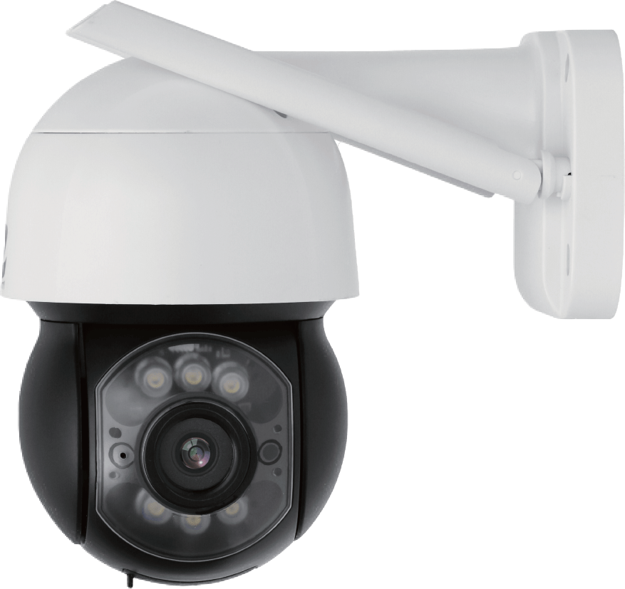
3 INCH HD WIFI MINI DOME CAMERA
Low power consumption
355° continued rotation
IR distance 20 meters
Human detection
Invasion alarm
Plug and play
Two-way voice call
Model No.
SR-WF11AR-300
SR-WF11AR-400
3Mpixes 4Mpixes
12.8V/18Ah(230.4Wh) LiFePO4
Effective Pixels
Protocols
Audio compression
G711U
CPU type
32 bit ARM CPU
Pan range
0°~355°, Horizontal

Slide 26


DELIVERING
THE SUN’S PROMISE
能源之诺｜向阳而生
Mob/WhatsApp/Wechat: +86 18926411545 Email: sales2@solarunoffgrid.com
Address: 1501A, Building C6, Hengfeng Industrial Zone, Hangcheng Street, Baoan District, Shenzhen City, Guangdong Province, China
www.solarunoffgrid.com

